Slide 1

Prepared by-
Rashmi Pradeep

Slide 2















Temporal and Environmental Factors Affecting Customer Visits
Analyzing how time and environmental conditions influence customer behavior and business operations
Temporal Patterns
Environmental Factors
Customer Behavior

Slide 3













Introduction & Methodology
Analysis Scope
Key Variables Examined
Examines how temporal and environmental factors influence customer visit patterns
Temporal Factors
Time of Day
Day of Week
Draws insights from comprehensive datasets containing visit records
Seasonality
Holidays
Focuses on identifying actionable patterns for business optimization
Environmental Factors
Weather Conditions
Temperature
Humidity
Wind Speed
Key Importance
"Understanding these dynamics is crucial for forecasting demand, optimizing resource allocation, and enhancing customer experience."

Slide 4










Hourly Visit Patterns
(PERMANENT REGISTRATION)
HOURLY TRIP DISTRIBUTION BY WEATHER
(CASUAL REGISTRATION)
Key Findings
Resource Implications
Peak hours: 17:00-18:00 with 573 customers
Staff peak hours (17:00-18:00)
Lowest hours: 2:00-5:00 with 5-16 customers
Reduce non-essential costs during low hours

Slide 5








Weekly & Holiday Patterns
Average Customer Visits by Day
Holiday Impact
40%
Holiday periods see a 40% reduction in customer visits
Key Insights
Weekday visits average 184 customers
Weekend visits average 183 customers
Holiday visits drop to 110 customers
Holidays significantly alter typical daily rhythms

Slide 6









Weather's Impact on Customer Traffic
Average Customer Visits by Weather Condition
Key Insights
Clear Weather Advantage
Clear weather conditions (Weather 1) yield the highest average visits at 204.86.
Severe Weather Impact
Heavy rain/snow (Weather 4) results in the lowest average visits at 43.00, a 79% drop from clear conditions.
Consistent Pattern
As weather deteriorates from clear to heavy precipitation, visits decrease predictably, showing a strong correlation.
Report Date: 2025-10-22

Slide 7







Temperature & Customer Behavior
Temperature & Visit Relationship
Key Insights
Customer visits increase with temperature up to an optimal range
Both extreme cold and heat negatively impact customer traffic
Peak visits occur at moderate temperatures (0.2-0.22)
Optimal temperatures see 60% more visits than extreme conditions
Report Date: 2025-10-22

Slide 8







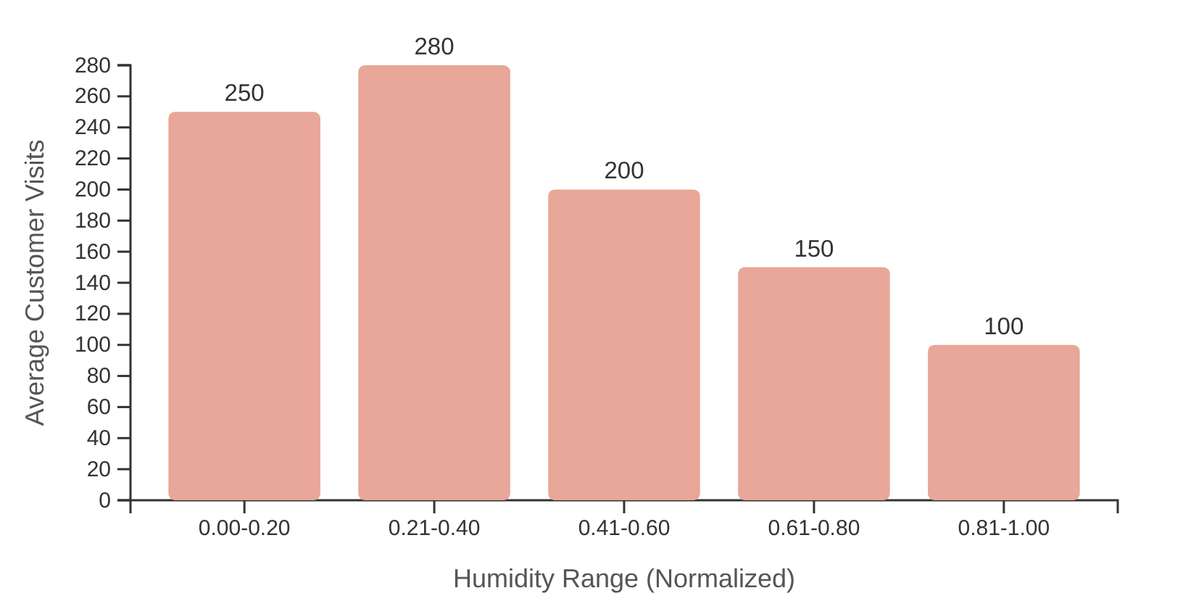
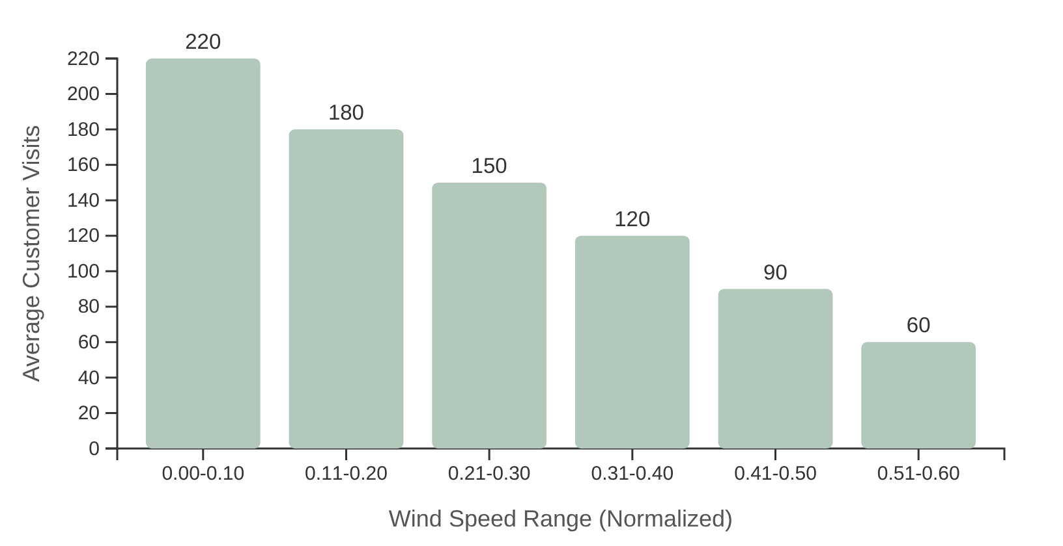


Humidity & Wind Speed Effects
Humidity Impact
Wind Speed Impact
Key Finding: Higher humidity levels correspond to significantly lower customer visits
Key Finding: Increasing wind speed negatively impacts customer traffic
Business Insight
Both high humidity and strong winds act as deterrents for potential customers. Optimal conditions for customer visits occur in low humidity (0.00-0.40) and minimal wind speed environments.

Slide 9














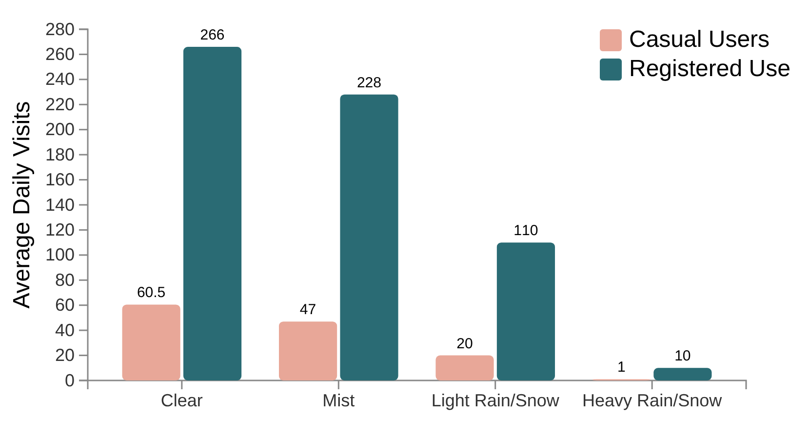



Casual vs. Registered User Behavior
User Segment Comparison
Weather Impact on Visits
Sensitivity to Conditions
Clear
Mist
Light Rain/Snow
Heavy Rain/Snow
Casual users show higher sensitivity to adverse weather conditions compared to registered users.
Visit Consistency
Registered users maintain more consistent visit patterns even during unfavorable conditions.
Proportional Response
During optimal conditions, both groups increase visits, but casual users show a higher proportional increase.
Key Insight:
Registered users are less deterred by minor inconveniences, possibly due to habit, specific needs, or benefits associated with their registration.
Data shows average daily visits by user type across different weather conditions
Report Date: 2025-10-22

Slide 10





















Key Insights & Predictors of Peak Demand
Key Insights Summary
Analysis reveals that peak customer demand occurs when optimal temporal and environmental factors align, particularly favoring weekends, late afternoon hours, and favorable weather conditions. Understanding these confluence points enables precise prediction of peak traffic periods.
Temporal Predictors
Environmental Predictors
Weekends: Saturday and Sunday show higher traffic, especially for casual users
Weather: Clear or partly cloudy conditions (Weather 1-2) maximize visits
Time of Day: Late afternoon to early evening (16:00-19:00) peak hours
Temperature: Optimal range between normalized 0.4-0.7, avoiding extremes
Holidays: Non-holiday weekdays show consistent registered user activity
Humidity: Low to moderate levels (below 0.4) preferred for higher visits
Wind Speed: Minimal wind (below 0.1) correlates with higher customer traffic
User Segment Response
Casual Users: More sensitive to weather conditions, prefer optimal environments
Registered Users: More consistent visit patterns, less deterred by minor inconveniences
Report Date: 2025-10-22

Slide 11






















Recommendations & Action Plan
Optimize Staffing & Operations
Targeted Marketing Campaigns
Mitigate Adverse Impact
Adjust staffing levels
Launch during favorable weather
Implement counter-strategies
Peak hours: 8-9 AM and 5-6 PM
Clear skies, moderate temperatures
Special promotions during bad weather
Focus on high-traffic days
Focus on peak seasons
Target registered users
Weekends, especially Saturdays
Less deterred by minor inconveniences
Leverage Seasonal Trends
Personalized Engagement
Strategic Benefits
Develop season-specific offerings
Utilize registered user data
Optimized resource allocation
Events for traditionally slow periods
Preferences and visit history
Enhanced customer experience
Enhance popular seasons
Encourage off-peak visits
Themed promotions for summer
During slower weather conditions
Increased operational efficiency
Implement these strategies to maximize customer engagement and operational effectiveness
Report Date: 2025-10-22

Slide 12
THANK YOU

